Slide 1
College Tech Math 1A
Sections 3.1, 3.2(1-3)
Percentage Conversions, Solving Percentage Problems

Slide 2
Essential Question
“Is the application of algebraic concepts a benefit to society?”

Slide 3
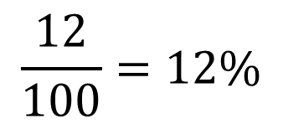
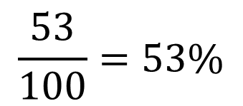
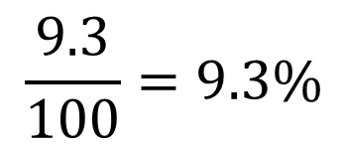
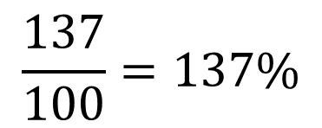
Percent
The word “percent” means “per 100”. The symbol for percent is “%”.
$$\frac{53}{100}=53\%$$
$$\frac{12}{100}=12\%$$
$$\frac{137}{100}=137\%$$
$$\frac{9.3}{100}=9.3\%$$

Slide 4
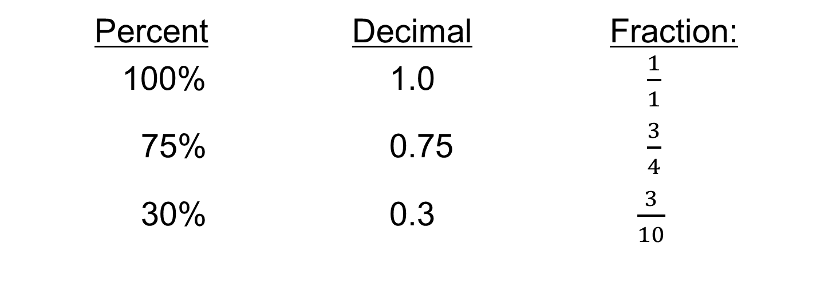
Percent
Working with percentages is a common skill in math. We are going to discuss the relationship between percentages, decimals, and fractions. For example:
Percent Decimal Fraction:
100% 1.0 $\frac{1}{1}$
75% 0.75 $\frac{3}{4}$
30% 0.3 $\frac{3}{10}$

Slide 5
Percent
Percent to Fraction:
Divide the percent by 100%, drop or “cancel” the % signs, and reduce the fraction to simplest form.

Slide 6


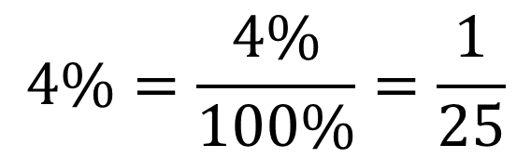
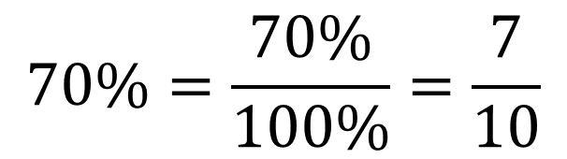
Convert each percent to a fraction. (Example)
$$70\%=\frac{70\%}{100\%}=\frac{7}{10}$$
$$a) 70\%$$
$$4\%=\frac{4\%}{100\%}=\frac{1}{25}$$
$$b) 4\%$$

Slide 7


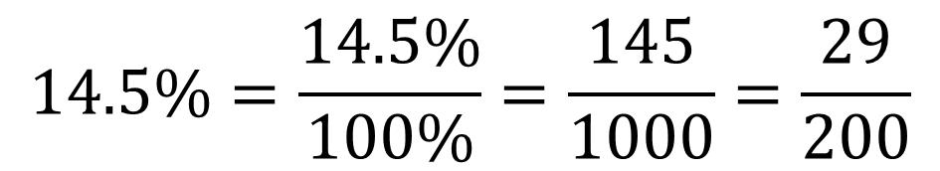
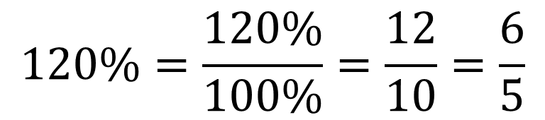
Convert each percent to a fraction. (Example)
$$120\%=\frac{120\%}{100\%}=\frac{12}{10}=\frac{6}{5}$$
$$c) 120\%$$
$$14.5\%=\frac{14.5\%}{100\%}=\frac{145}{1000}=\frac{29}{200}$$
$$d) 14.5\%$$

Slide 8
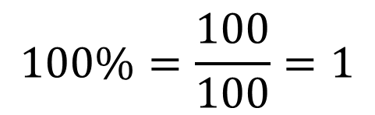
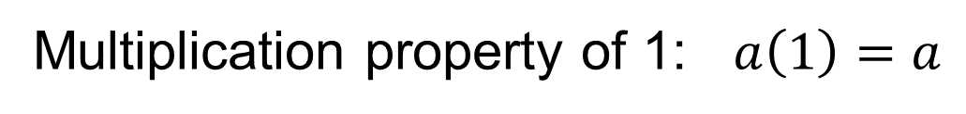
The method to convert a fraction to a percent we use the following properties of mathematics.
Multiplication property of 1: $a\left(1\right)=a$
$$100\%=\frac{100}{100}=1$$
If we multiply a fraction by 100% (1) we will not change the value of the fraction but will change to a percentage.

Slide 9
Percent
Fraction to Percent:
Multiply the fraction by 100%, which “adds” the % sign, and reduce the fraction to simplest form.

Slide 10
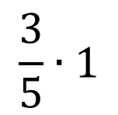
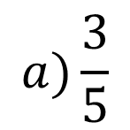

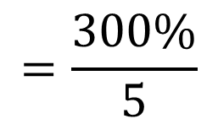
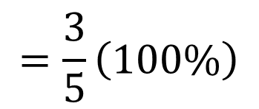
Convert each fraction to a percent. If necessary, round the percentage to the nearest tenth. (Example)
$$a)\frac{3}{5}$$
$$\frac{3}{5}∙1$$
$$=\frac{3}{5}\left(100\%\right)$$
$$=\frac{300\%}{5}$$
$$=60\%$$

Slide 11
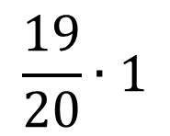
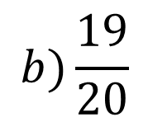

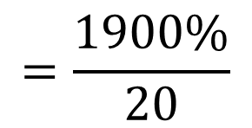
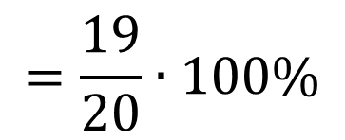
Convert each fraction to a percent. If necessary, round the percentage to the nearest tenth. (Example)
$$b)\frac{19}{20}$$
$$\frac{19}{20}∙1$$
$$=\frac{19}{20}∙100\%$$
$$=\frac{1900\%}{20}$$
$$=95\%$$

Slide 12
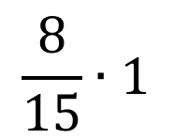
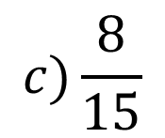

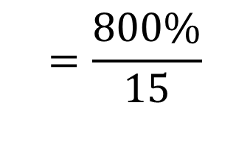
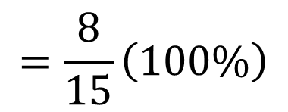
Convert each fraction to a percent. If necessary, round the percentage to the nearest tenth. (Example)
$$c)\frac{8}{15}$$
$$\frac{8}{15}∙1$$
$$=\frac{8}{15}\left(100\%\right)$$
$$=\frac{800\%}{15}$$
$$=53.3\%$$

Slide 13
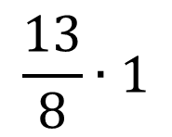
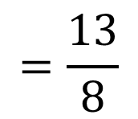
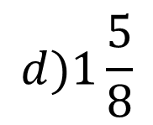

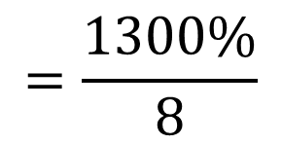
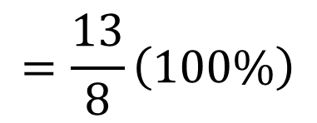
Convert each fraction to a percent. If necessary, round the percentage to the nearest tenth. (Example)
$$d)1\frac{5}{8}$$
$$=\frac{13}{8}$$
$$\frac{13}{8}∙1$$
$$=\frac{13}{8}\left(100\%\right)$$
$$=\frac{1300\%}{8}$$
$$=162.5\%$$

Slide 14
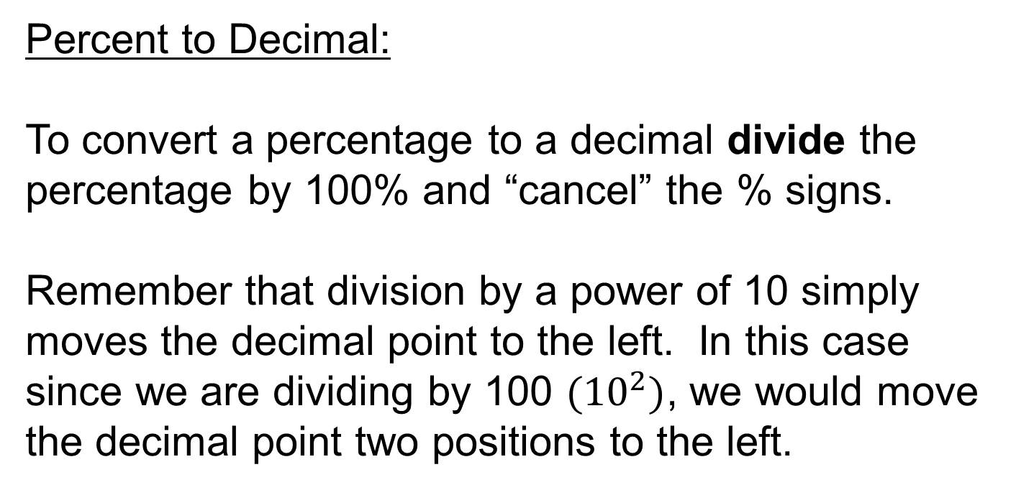
Percent to Decimal:
To convert a percentage to a decimal divide the percentage by 100% and “cancel” the % signs.
Remember that division by a power of 10 simply moves the decimal point to the left. In this case since we are dividing by 100 ${(10}^{2})$, we would move the decimal point two positions to the left.

Slide 15


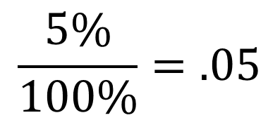
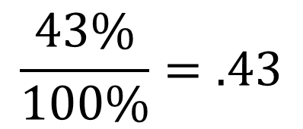
Convert each percentage to a decimal (Example)
$$a) 43\%$$
$$\frac{43\%}{100\%}=.43$$
$$b) 5\%$$
$$\frac{5\%}{100\%}=.05$$

Slide 16

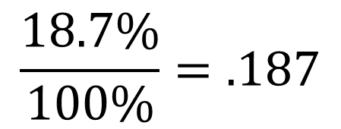
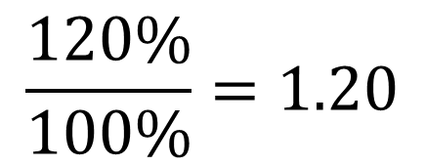
Convert each percentage to a decimal (Example)
$$c) 120\%$$
$$\frac{120\%}{100\%}=1.20$$
$$d) 18.7\%$$
$$\frac{18.7\%}{100\%}=.187$$

Slide 17
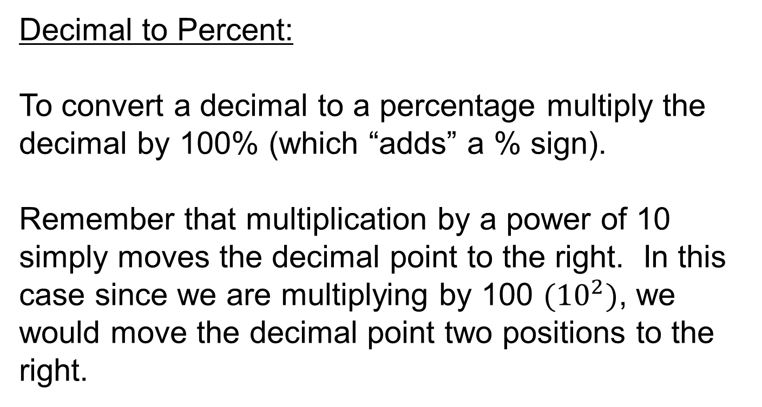
Decimal to Percent:
To convert a decimal to a percentage multiply the decimal by 100% (which “adds” a % sign).
Remember that multiplication by a power of 10 simply moves the decimal point to the right. In this case since we are multiplying by 100 $({10}^{2})$, we would move the decimal point two positions to the right.

Slide 18




Convert each decimal to a percentage (Example)
$$a) .32$$
$$.32\left(100\%\right)=32\%$$
$$b) .09$$
$$.09(100\%)=9\%$$

Slide 19




Convert each decimal to a percentage (Example)
$$c) 2.34$$
$$2.34(100\%)=234\%$$
$$d) .116$$
$$.116(100\%)=11.6\%$$

Slide 20
Fraction Decimal Percent
4/5 .8 80%
3/5 .6 60%
1/40 .025 2.5%
1/200 .005 .5%

Slide 21
Fraction Decimal Percent
7/20 .35 35%
3/2000 .0015 .15%
1/90 .01111... 1 1/9%
2 ½ 2.5 250%

Slide 22
Percentage Problems
Base $(B)$ is the original or total amount in the problem.
Base is the total amount, original amount, or entire amount. It is the amount that the portion is a part of. In a sentence the base is often closely associated with the preposition “of”.

Slide 23
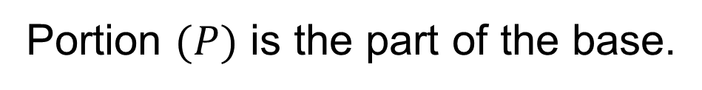
Percentage Problems
Portion $(P)$ is the part of the base.
Portion can refer to the part, partial amount, amount of increase or decrease, or amount of change. It is a portion of the base. In a sentence the portion is often closely associated with a form of the verb “is”.

Slide 24
Percentage Problems
Rate $(R)$ is the percentage given in the problem.
Rate is usually written as a percent, but it may be a decimal or fraction.

Slide 25
To methods for solving percent problems:
Percent Formula
$$P=B x R$$
$$B=\frac{P}{R}$$
$$R=\frac{P}{B}$$
P
NOTE:
Percent must be a decimal
3 Versions
R
B

Slide 26
To methods for solving percent problems:
Proportion Method
$$\frac{Rate\left(R\right)}{100}=\frac{Portion\left(P\right)}{Base\left(B\right)}$$
P
NOTE:
Percent must be a percent
1 Version
R
B

Slide 27
Important Note
When setting up your percentage problems always make sure that the rate (percentage) and portion represent the same quantity.

Slide 28
Percentage Problems – Method 1
P (portion)
This circle can help you solve percentage problems.
R (rate)
B (base)

Slide 29
Percentage Problems – Method 1
When solving for the portion (P), multiply the rate (R) and the base (B). Note the rate must be written in decimal form if using the Percent Formula.
P (portion)
R (rate)
B (base)

Slide 30
Percentage Problems – Method 1
P (portion)
When solving for the rate (R), divide the portion (P) by the base (B).
R (rate)
B (base)

Slide 31
Percentage Problems – Method 1
When solving for the base (B), divide the portion (P) by the rate (R). Note the rate must be written in decimal form if using the Percent Formula.
P (portion)
R (rate)
B (base)

Slide 32
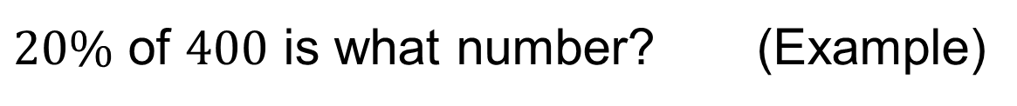
Percentage Problems – Method 1
$20\%$ of $400$ is what number? (Example)
P (portion)
R (rate)
B (base)

Slide 33
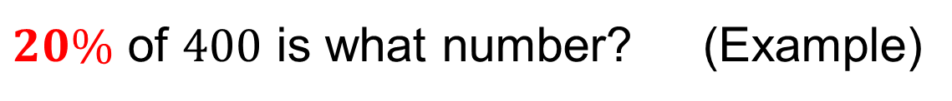
Percentage Problems – Method 1
$20\%$ of $400$ is what number? (Example)
P (portion)
B (base)
.20

Slide 34
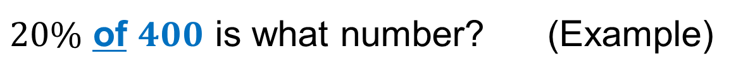
Percentage Problems – Method 1
$20\%$ of $400$ is what number? (Example)
P (portion)
.20
400

Slide 35

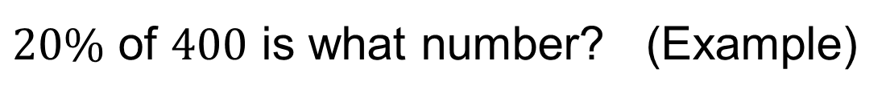
Percentage Problems – Method 1
$20\%$ of $400$ is what number? (Example)
$$P=.20\left(400\right)=80$$
P (portion)
.20
400

Slide 36
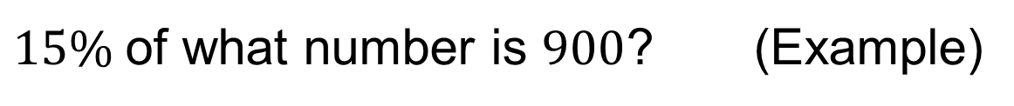
Percentage Problems – Method 1
$15\%$of what number is $900$? (Example)
P (portion)
R (rate)
B (base)

Slide 37
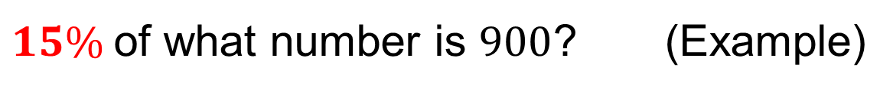
Percentage Problems – Method 1
$15\%$of what number is $900$? (Example)
P (portion)
B (base)
.15

Slide 38
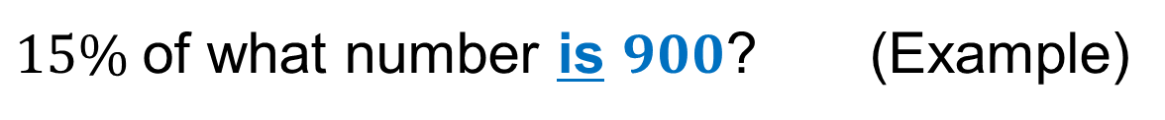
Percentage Problems – Method 1
$15\%$of what number is $900$? (Example)
900
B (base)
.15

Slide 39
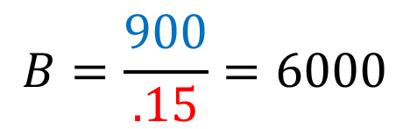
Percentage Problems – Method 1
$15\%$of what number is $900$? (Example)
900
$$B=\frac{900}{.15}=6000$$
B (base)
.15

Slide 40

Percentage Problems – Method 1
What percent of $725$is $94.25$? (Example)
P (portion)
R (rate)
B (base)

Slide 41
Percentage Problems – Method 1
What percent of $725$is $94.25$? (Example)
P (portion)
R (rate)
725

Slide 42
Percentage Problems – Method 1
What percent of $725$is $94.25$? (Example)
94.25
R (rate)
725

Slide 43
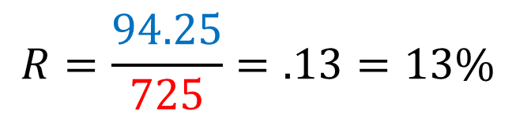
Percentage Problems – Method 1
What percent of $725$is $94.25$? (Example)
94.25
$$R=\frac{94.25}{725}=.13=13\%$$
R (rate)
725

Slide 44
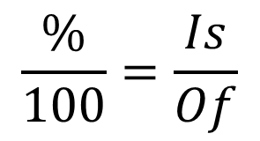
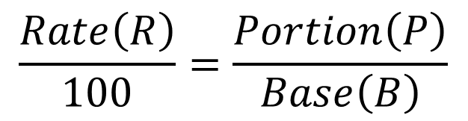
Percentage Problems – Method 2
We can use proportions and the cross product to solve problems involving percentages.
$$\frac{Rate\left(R\right)}{100}=\frac{Portion\left(P\right)}{Base\left(B\right)}$$
$$\frac{\%}{100}=\frac{Is}{Of}$$

Slide 45
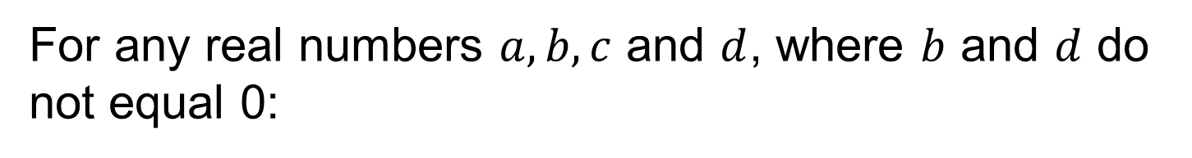
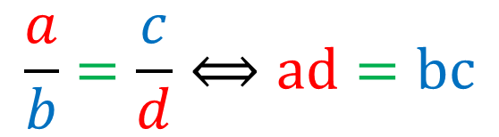
Cross Product
For any real numbers $a,b,c$ and $d$, where $b$ and $d$ do not equal 0:
$$\frac{a}{b}=\frac{c}{d}⟺ad=bc$$

Slide 46
Percentage Problems – Method 2
$20\%$ of $400$ is what number? (Example)

Slide 47
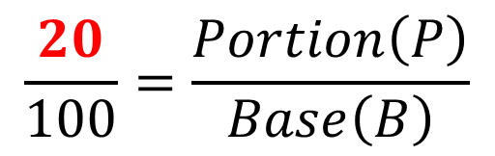
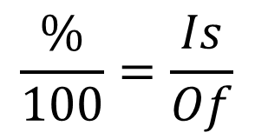
Percentage Problems – Method 2
$20\%$ of $400$ is what number? (Example)
$$\frac{20}{100}=\frac{Portion\left(P\right)}{Base\left(B\right)}$$
You do not have to convert the rate to a decimal.
$$\frac{\%}{100}=\frac{Is}{Of}$$

Slide 48

Percentage Problems – Method 2
$20\%$ of $400$ is what number? (Example)
$$\frac{20}{100}=\frac{Portion\left(P\right)}{400}$$
$$\frac{\%}{100}=\frac{Is}{Of}$$

Slide 49



Percentage Problems – Method 2
$20\%$ of $400$ is what number? (Example)
$$\frac{20}{100}=\frac{Portion\left(P\right)}{400}$$
$$100P=20(400)$$
$$100P=8000$$
$$\frac{\%}{100}=\frac{Is}{Of}$$
$$P=80$$

Slide 50
Percentage Problems – Method 2
$15\%$of what number is $900$? (Example)

Slide 51

Percentage Problems – Method 2
$15\%$of what number is $900$? (Example)
$$\frac{15}{100}=\frac{Portion\left(P\right)}{Base\left(B\right)}$$
$$\frac{\%}{100}=\frac{Is}{Of}$$

Slide 52

Percentage Problems – Method 2
$15\%$of what number is $900$? (Example)
$$\frac{15}{100}=\frac{900}{Base\left(B\right)}$$
$$\frac{\%}{100}=\frac{Is}{Of}$$

Slide 53





Percentage Problems – Method 2
$15\%$of what number is $900$? (Example)
$$\frac{15}{100}=\frac{900}{Base\left(B\right)}$$
$$15B=100(900)$$
$$15B=90000$$
$$\frac{\%}{100}=\frac{Is}{Of}$$
$$B=6000$$

Slide 54
Percentage Problems – Method 2
What percent of $725$is $94.25$? (Example)

Slide 55

Percentage Problems – Method 2
What percent of $725$is $94.25$? (Example)
$$\frac{Rate(R)}{100}=\frac{Portion\left(P\right)}{725}$$
$$\frac{\%}{100}=\frac{Is}{Of}$$

Slide 56

Percentage Problems – Method 2
What percent of $725$is $94.25$? (Example)
$$\frac{Rate(R)}{100}=\frac{94.25}{725}$$
$$\frac{\%}{100}=\frac{Is}{Of}$$

Slide 57





Percentage Problems – Method 2
What percent of $725$is $94.25$? (Example)
$$\frac{Rate(R)}{100}=\frac{94.25}{725}$$
$$725R=100(94.25)$$
$$725R=9425$$
$$\frac{\%}{100}=\frac{Is}{Of}$$
$$R=13\%$$

